Slide 1

Research Paper Presentation
Brendon Simonsen

Slide 2

Title: Constable: Improving Performance and Power Efficiency by Safely Eliminating Load Instruction Execution
Authors: Rahul Bera; Adithya Ranganathan; Joydeep Rakshit; Sujit Mahto; Anant V. Nori; Jayesh Gaur
Publication Venue: ISCA 2024 (ACM/IEEE International Symposium on Computer Architecture)
Notes:
This paper was published at ISCA 2024, one of the top computer architecture conferences.
The work proposes a microarchitectural optimization called Constable.
The key idea is eliminating certain load instructions entirely to improve CPU performance and energy efficiency.

Slide 3
The Problem
Why Focus on Load Instructions?
Loads are very common in modern programs
They introduce:
Memory latency
Pipeline resource usage
Data dependencies
Memory accesses consume significant power
Notes:
Load instructions frequently appear in loops.
Many variables remain constant for long periods.
Executing these loads repeatedly wastes resources.
The paper asks: What if we could safely skip these loads?

Slide 4
Microarchitectural Mechanism
A microarchitectural mechanism is an internal hardware technique used by a processor to execute instructions more efficiently while preserving the behavior defined by the instruction set architecture.

Slide 5
Current Solutions
Load Value Prediction (LVP)
Predicts the value a load will return
Allows dependent instructions to execute early
Load still executes to verify prediction
Limitation: Does not eliminate memory access or pipeline resource usage.
Memory Renaming (MRN)
Tracks relationships between stores and later loads
Allows loads to obtain values directly from earlier stores
Reduces memory access latency
Limitation: Only works when a load reads a value from a recent store.

Slide 6
Big Idea of Constable
A microarchitectural mechanism that:
Detects stable loads
Safely replaces their execution
Benefits
Fewer memory accesses
Reduced pipeline pressure
Lower power consumption
LOAD R1 ← MEM[A] → 5
LOAD R1 ← MEM[A] → 5
LOAD R1 ← MEM[A] → 5
MOV R1 ← cached_value
Notes:
If the CPU already knows what value the load will return, it can reuse the value.
This removes the need to access the memory hierarchy.
That improves both performance and energy efficiency.

Slide 7
Architecture
Main Components:
Stable Load Detector (SLD)
Register Monitor Table (RMT)
Address Monitor Table (AMT)
Process:
Detect stable load
Monitor dependencies
Replace load with cached value
Notes:
These three hardware structures work together.
Detection identifies candidate loads.
Monitoring ensures correctness.
If safe, the load is replaced with a simple value move.

Slide 8
Stable Load Detector (SLD)
Constable identifies loads that:
Access the same memory address
Return the same value repeatedly
SLD Purpose:
Identify likely-stable loads
Decision of eliminating a load
Store load instruction address and fetched data
Once confidence is high → load becomes stable
Notes:
The hardware monitors loads dynamically.
When a load repeatedly produces the same value, the system builds confidence.
After reaching a threshold, the load is marked as stable.

Slide 9
Conditions
Conditions for eliminating a load instruction:
1. The address register has not changed
- Tracked by the RMT
2. The memory location was not modified
- Tracked by the AMT
Notes:
Eliminating loads is only safe if the value truly hasn’t changed.
The architecture tracks register updates and memory writes.
If anything changes, the load is re-executed to ensure correctness.

Slide 10
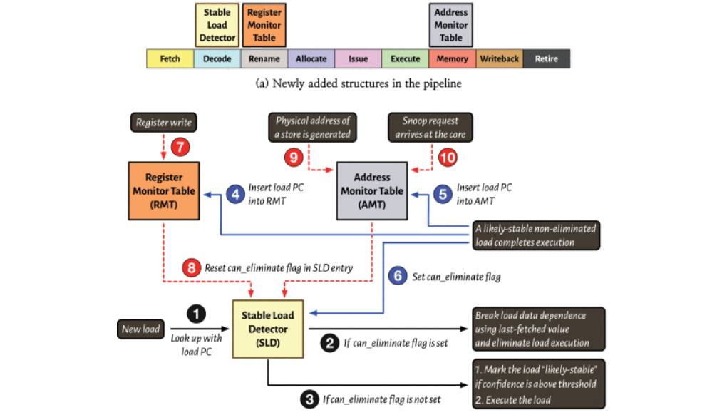

Slide 11
Comparison
Technique | Idea | Limitation
LVP | Predict Load Values | Load still executes
MRN | Forward values from stores | Only works for store → load cases
Constable | Eliminate stable loads | Requires value stability
Notes:
Programs are running 5.1% faster
Dynamic power is the energy consumed when transistors switch during execution.
(SMT) allows multiple threads to run on the same CPU core at the same time.
The paper evaluates Constable using standard benchmark suites commonly used in computer architecture research
Constable requires about 12 kilobytes of additional hardware storage inside each CPU core.

Slide 12
Performance
Evaluation across 90 workloads from SPEC CPU 2017
Results:
+5.1% performance improvement
−3.4% dynamic power
+8.8% performance with Simultaneous Multithreading (SMT)
Hardware overhead: ~12 KB per core
Notes:
Programs are running 5.1% faster
Dynamic power is the energy consumed when transistors switch during execution.
(SMT) allows multiple threads to run on the same CPU core at the same time.
The paper evaluates Constable using standard benchmark suites commonly used in computer architecture research
Constable requires about 12 kilobytes of additional hardware storage inside each CPU core.

Slide 13
Key Takeaways
Many loads repeatedly read unchanged values
Constable detects stable loads
Safely eliminates their execution
Results:
Improved performance
Reduced power consumption
Minimal hardware cost
Notes:
The big insight is that some instructions are redundant.
Eliminating them directly improves efficiency.

Slide 14
Simulated Q&A

Slide 15
How is correctness ensured if memory values can change at any time?
Register Monitor Table (RMT)
Tracks the registers used to compute the load address.
If any of those registers change, the load may reference a different memory location, so the load is executed normally again.
Address Monitor Table (AMT)
Tracks the memory addresses associated with stable loads.
If a store writes to that address, the cached value becomes invalid and the load must be executed again.
These safeguards ensure that loads are only eliminated when there is a high level of confidence that the value has not changed.

Slide 16
What types of workloads benefit the most from Constable?
Performs best in workloads where loads frequently read unchanged data from memory.
Some examples include:
Loop-invariant variables
Configuration parameters
Constant lookup tables
Shared data structures or variables that rarely change

Slide 17
Title
Content

